Slide 1
Blood Donation Tracker System
A Smart Data Science Solution for Emergency Readiness
Name – Rishabh Prasad Bhagat.
College Email id- rishabh_2312res518@iitp.ac.in
IIT Patna

Slide 2
Problem Statement
Why This Project Matters
Blood shortages delay emergency care and critical surgeries
No centralized system to track donor contributions or stock levels
Hospitals lack real-time visibility into blood availability
Urgent need for a smart, data-driven solution to manage blood inventory

Slide 3
Project Objective
What We Built
A system to monitor donor activity and blood stock levels
Automated alerts for low inventory
Exportable reports for hospital use
Predictive model to forecast shortage risk
Visual dashboards for quick decision-making

Slide 4
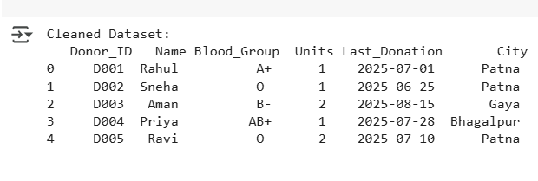
Dataset & Cleaning
Data Collection & Preparation
Dataset includes 20 donors across 5 cities
Blood group formats standardized (e.g., “A+” → “A Positive”)
Removed duplicate entries and null values
Dates converted to consistent format
Final dataset ready for analysis and modeling

Slide 5
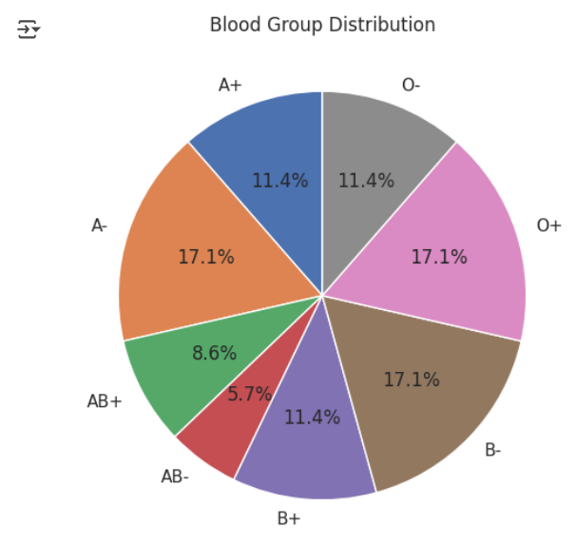
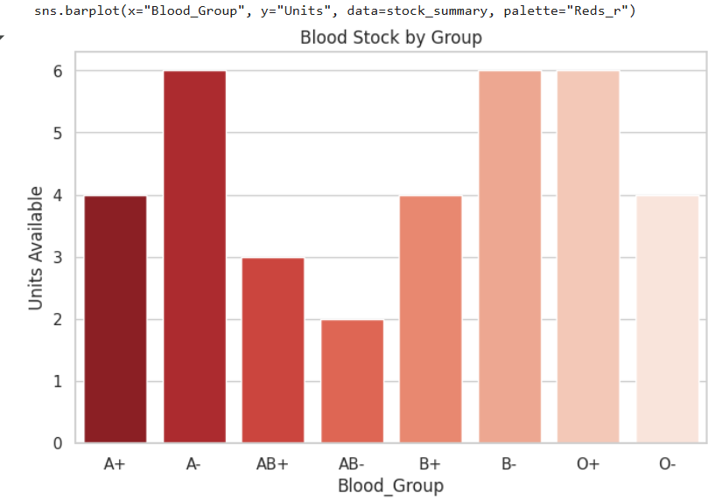
Data Analysis & Charts

Slide 6
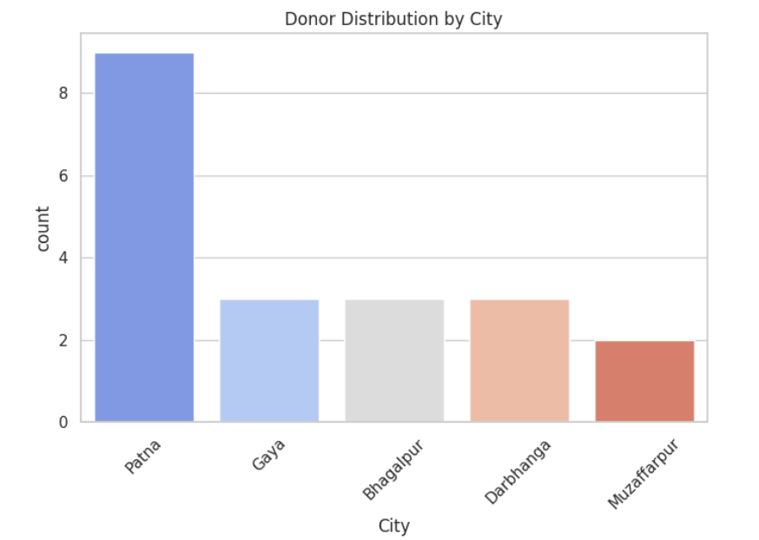

Slide 7
🚨 Alert System
Detecting Shortages
Threshold set at 3 units per blood group
System checks stock and triggers alerts Example Output: ⚠ ALERT: Low stock for AB- ( Only 2 units left)
Helps hospitals prioritize urgent donations and procurement

Slide 8
🩸 Predictive Model
Forecasting Risk
Model Used: Random Forest Classifier
Features:
Days since last donation
Units available
Donor city
Target Variable: Risk of shortage (Yes/No)
Output: Predicts which blood groups are likely to run low soon based on donation patterns and current stock levels.

Slide 9
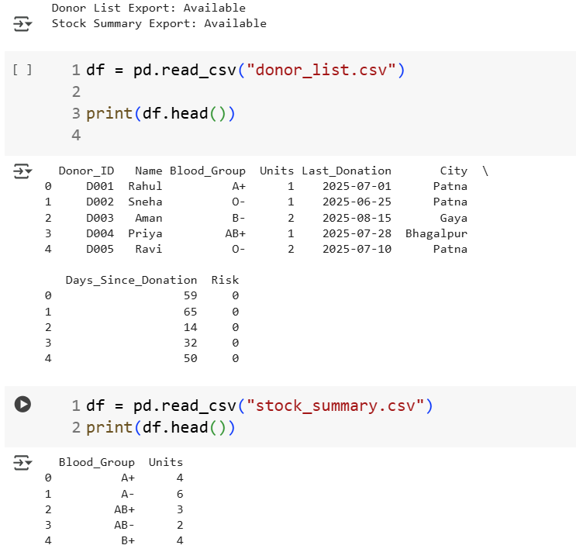

Slide 10
📐 Model Evaluation
Accuracy & Reliability
Confusion Matrix shows true vs predicted outcomes
Classification Report includes:
Precision
Recall
F1-Score
Model performs well on identifying high-risk blood groups

Slide 11
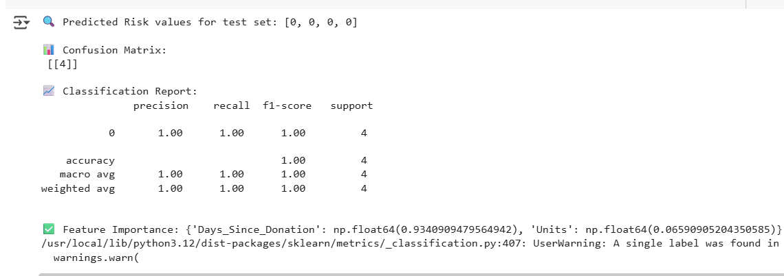

Slide 12
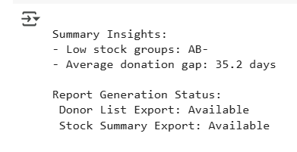
Summary Insights
Key Findings
AB- is the most critically low blood group
Average donation gap: 35.2 days
Donor List Export: ✅ Available
Stock Summary Export: ✅ Available
Alert System: ✅ Functional
Predictive Model: ✅ Integrated

Slide 13
🏁 Conclusion
Impact & Future Scope
This system transforms raw donor data into life-saving decisions
Enables hospitals to act faster and plan better
Scalable for larger datasets and real-time integration

Slide 14


